Slide 1

Real Estate
Market
in King County
Data-driven insights and predictive modelling

Slide 2
Business Understanding
Goal - create a platform that delivers accurate estimates of house prices
Develop a model that can identify the key factors influencing house prices.
Requirements - precise and representative data related to the real estate market in king county,
Notes:
-Primary goal is to create a platform that delivers accurate estimates of house prices which are crucial for both buyers and sellers in King county.
-To achieve this objective we need to develop a model that can identify the key factors influencing house prices.
-To effectively train this model the client requires precise and representative data related to the real estate market in king county, including historical sales, current listings, property size, and other relevant features.
-. The expectation is that, once completed, the model can be used by them as a tool in selecting properties for investment in King County.

Slide 3
Problem Statement
Advertising Campaign to encourage sales in King County
● Data-driven recommendations
● Model to predict house prices

Slide 4
Analysis
Qn 1: What features are most closely connected with changes in house prices?
Qn 2: Which features show the strongest connections with other factors that help predict house prices?
Qn 3: What combination of features gives the most accurate predictions for how much a house will cost?

Slide 5
Methodology
● Gather relevant data and perform comprehensive analysis to understand its structure, quality, and potential insights
● Delve into the features of the dataset to uncover meaningful patterns and insights that can inform the prediction model.
● Construct a prediction model using appropriate methodologies, incorporating the insights gained from data analysis and feature investigation.

Slide 6
Correlations between price and sqft_living;
The graph below shows a relatively strong positive correlations between price and sqft_living at 0.7, sqft_above at 0.61, sqft_living15 at 0.59 and number of bathrooms at 0.53.
The weakest positive correlations were between price and number of bedrooms at 0.31, sqft_lot at 0.09, number of floors at 0.26 and sqft_lot15 at 0.08.
The weakest inverse correlations were between price and zipcode and age at -0.05, and month sold at -0.01.

Slide 7
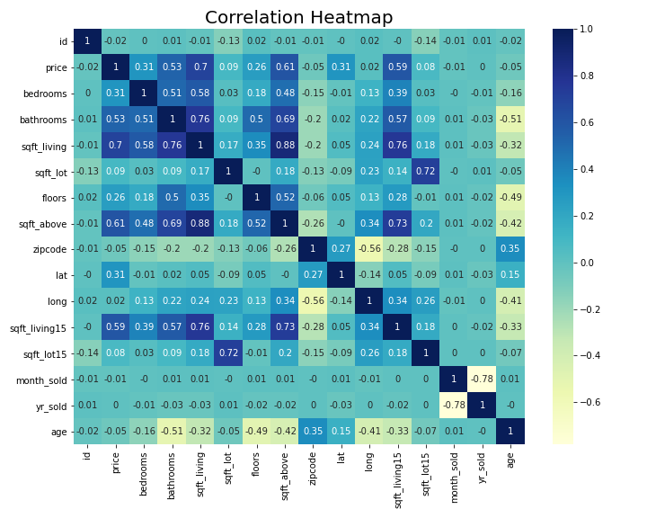

Slide 8
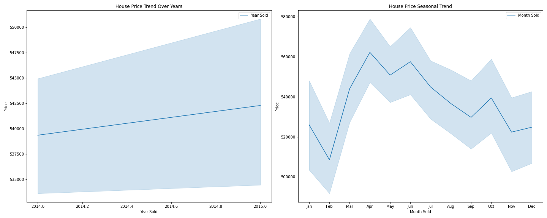
Investigation on house price trends over the year and over the specific months/seasons.

Slide 9
The graph above concludes that:
That house prices were on a steady rise from 2014 to 2015 with the highest house prices recorded in the month of April and the lowest in the month of February.
Investigations are required to find out why house prices drastically rose between February and April and why prices fell between June and September.

Slide 10
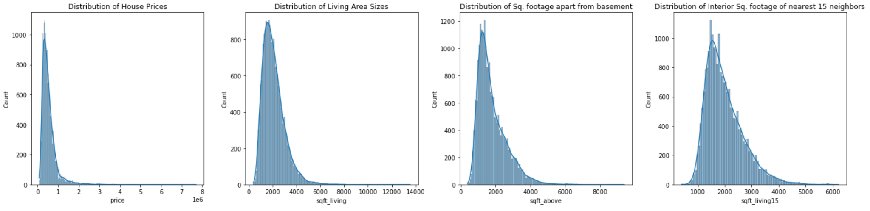
Exploring the distributions of the variables with the strongest positive relationships with price.

Slide 11
POST-NORMALIZATION

Slide 12
The histogram above infers that;
Our variables follows a normal distribution with skewness and kurtosis in all the distributions.
This will help inform further analysis and decision-making.

Slide 13
In the graph below;
We analyzed the variation of average house prices as per the overall condition of a house, whether a house is located on a waterfront or not, the quality of views from the house and the number of floors/ levels in a house.

Slide 14
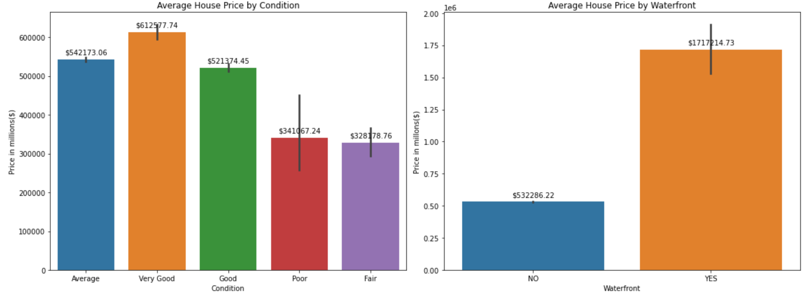

Slide 15
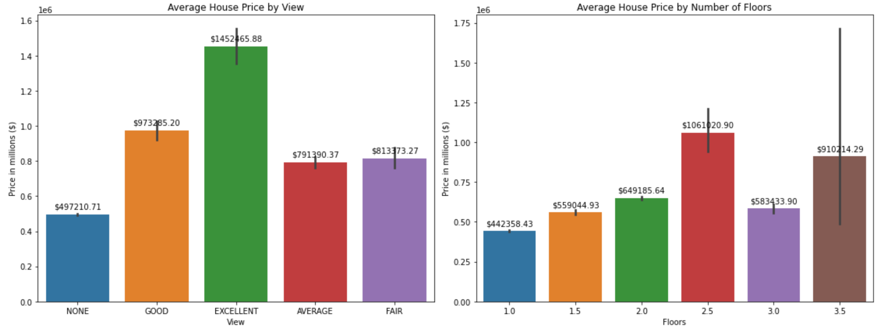

Slide 16
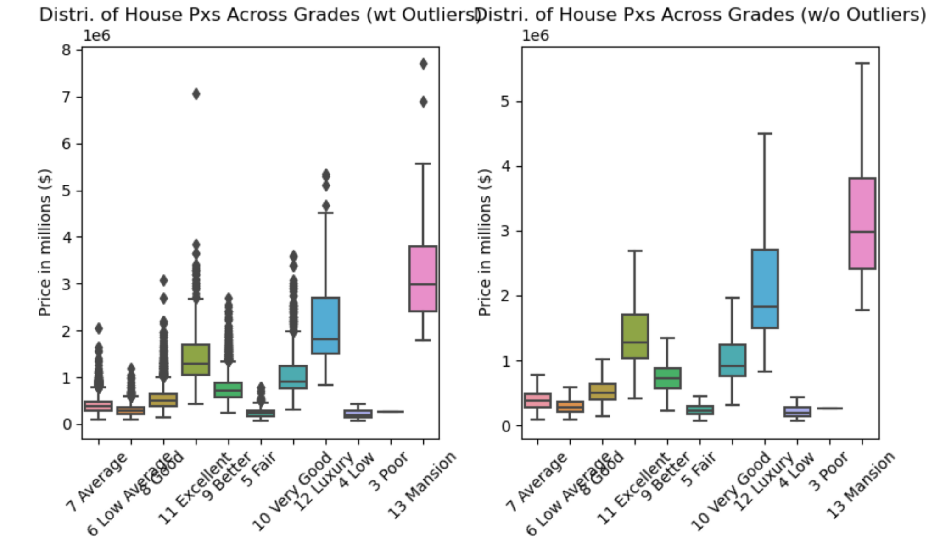
Assess the change in house price values as per the grade, condition and waterfront location of a house with and without outliers using box plots as shown below.

Slide 17
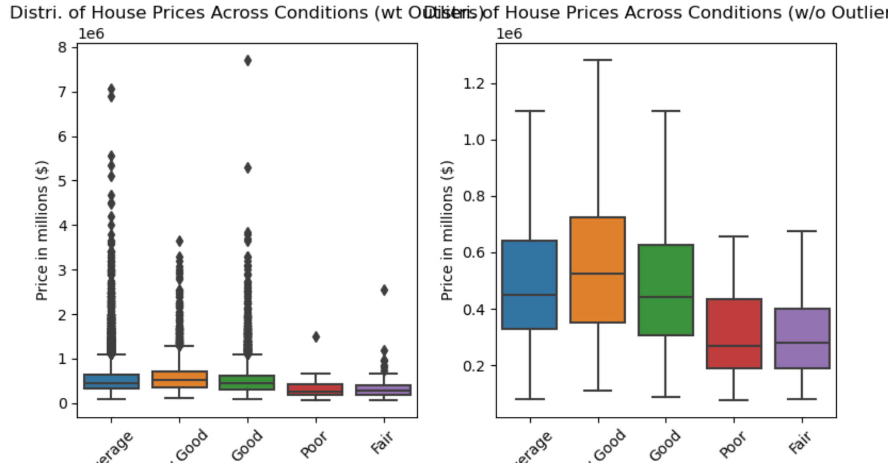

Slide 18
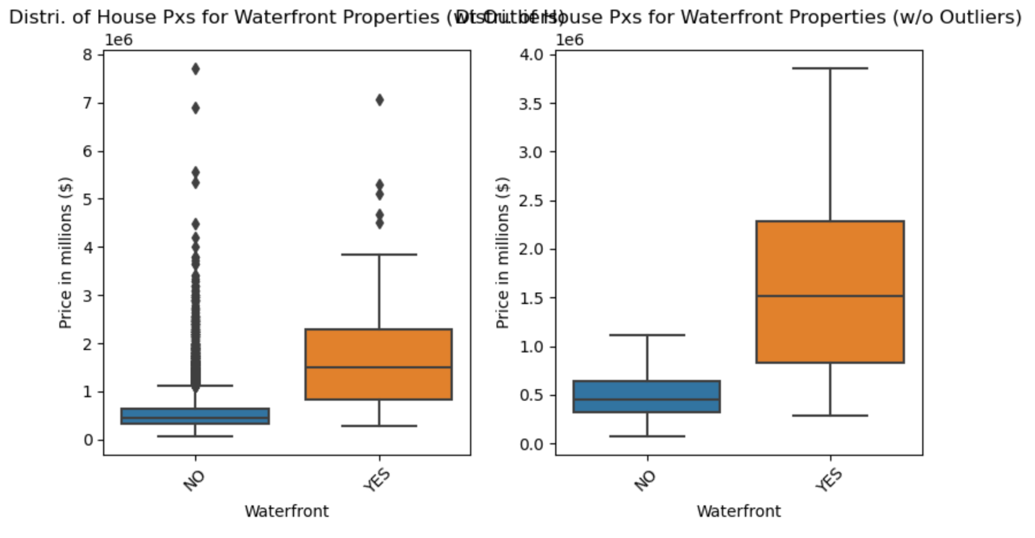

Slide 19
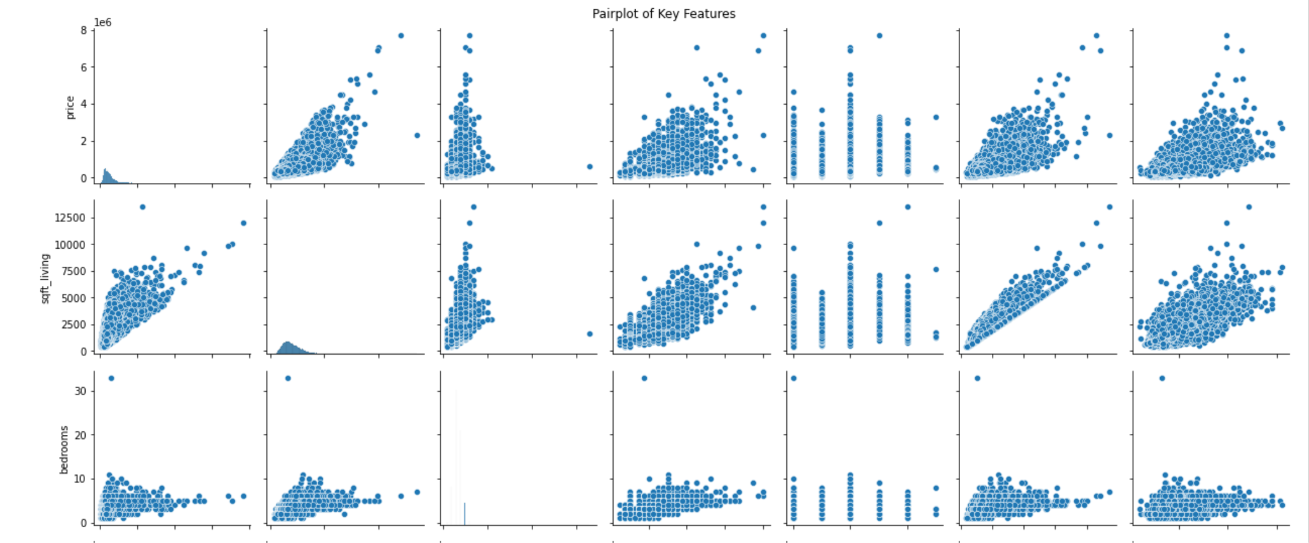
Scatterplots to visualise and better explore the relationships between multiple variables listed below. This allowed us to infer which variables showed linear relationships with one another

Slide 20
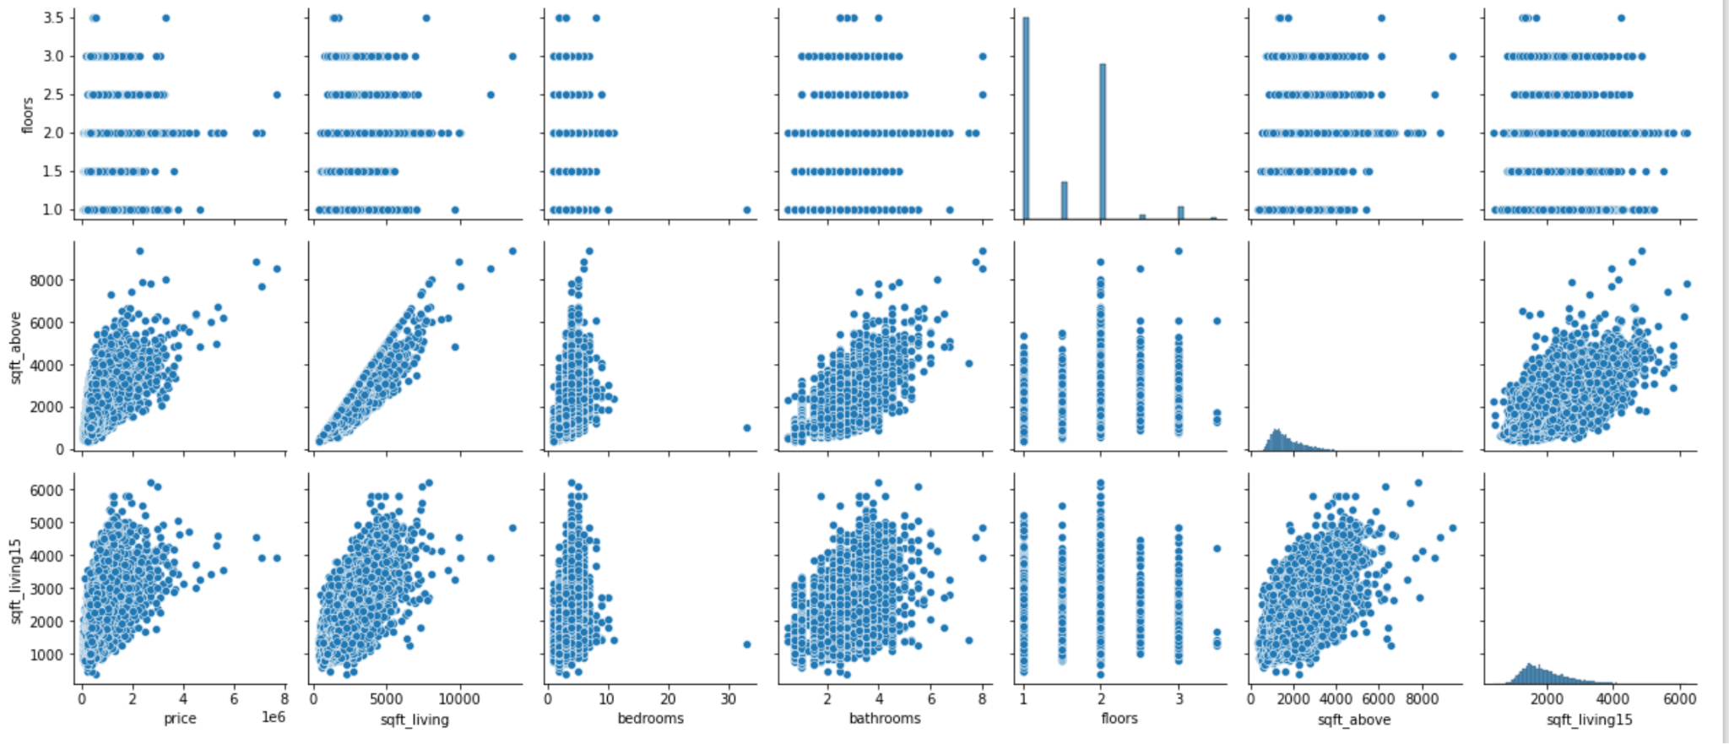

Slide 21
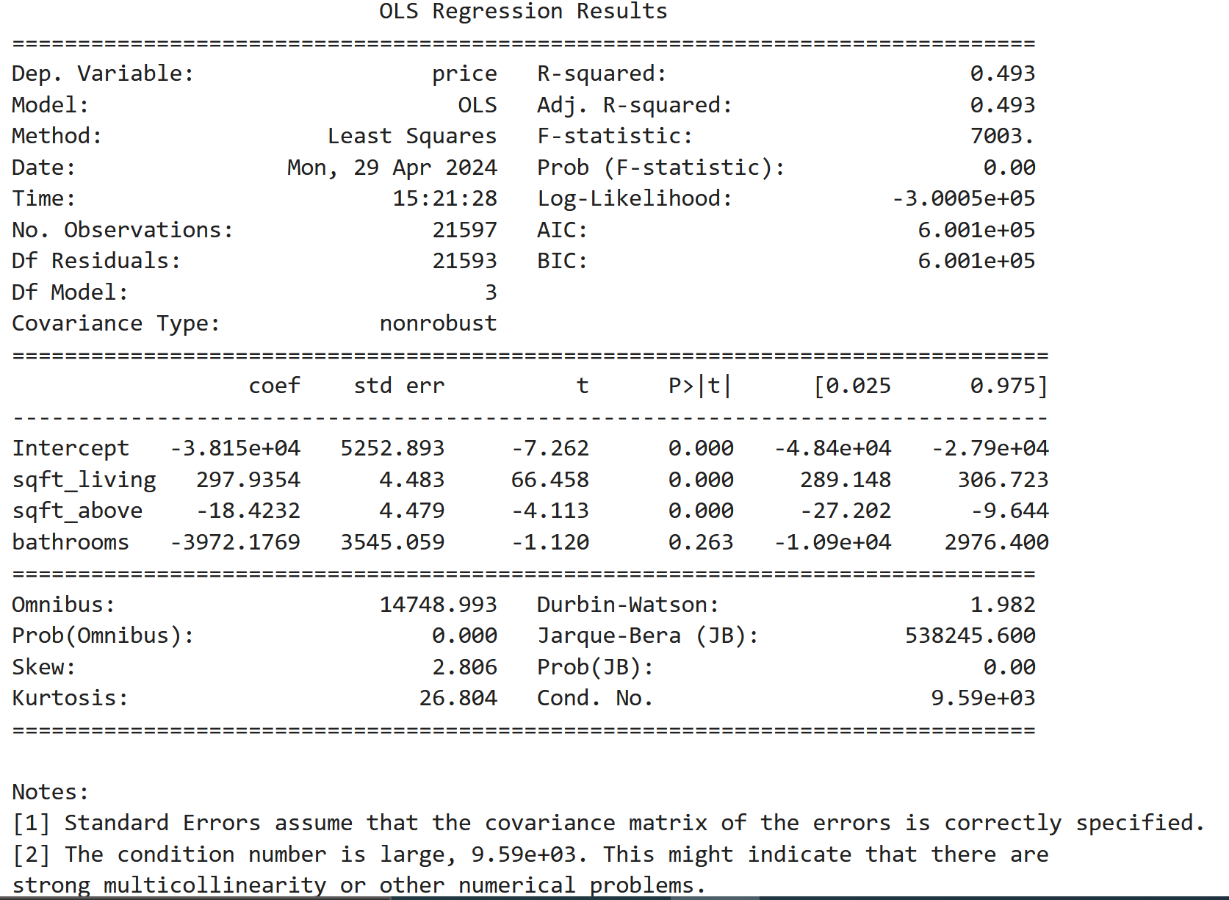
General overview on the variables that have a strong correlation with the price

Slide 22
Analysis suggests that the square footage of living space (sqft_living) shows the strongest positive correlation with the price, marked at 0.7.
This indicates that the size of the living area significantly impacts the price.
The year the house was built (yr built) has a weaker positive correlation with price, at 0.5, suggesting that the house's age has a less pronounced effect on its price.

Slide 23
Next:
Linear regression model with price as the dependent variable and sqft_living as the independent variable to determine the coefficient and y-intercept

Slide 24
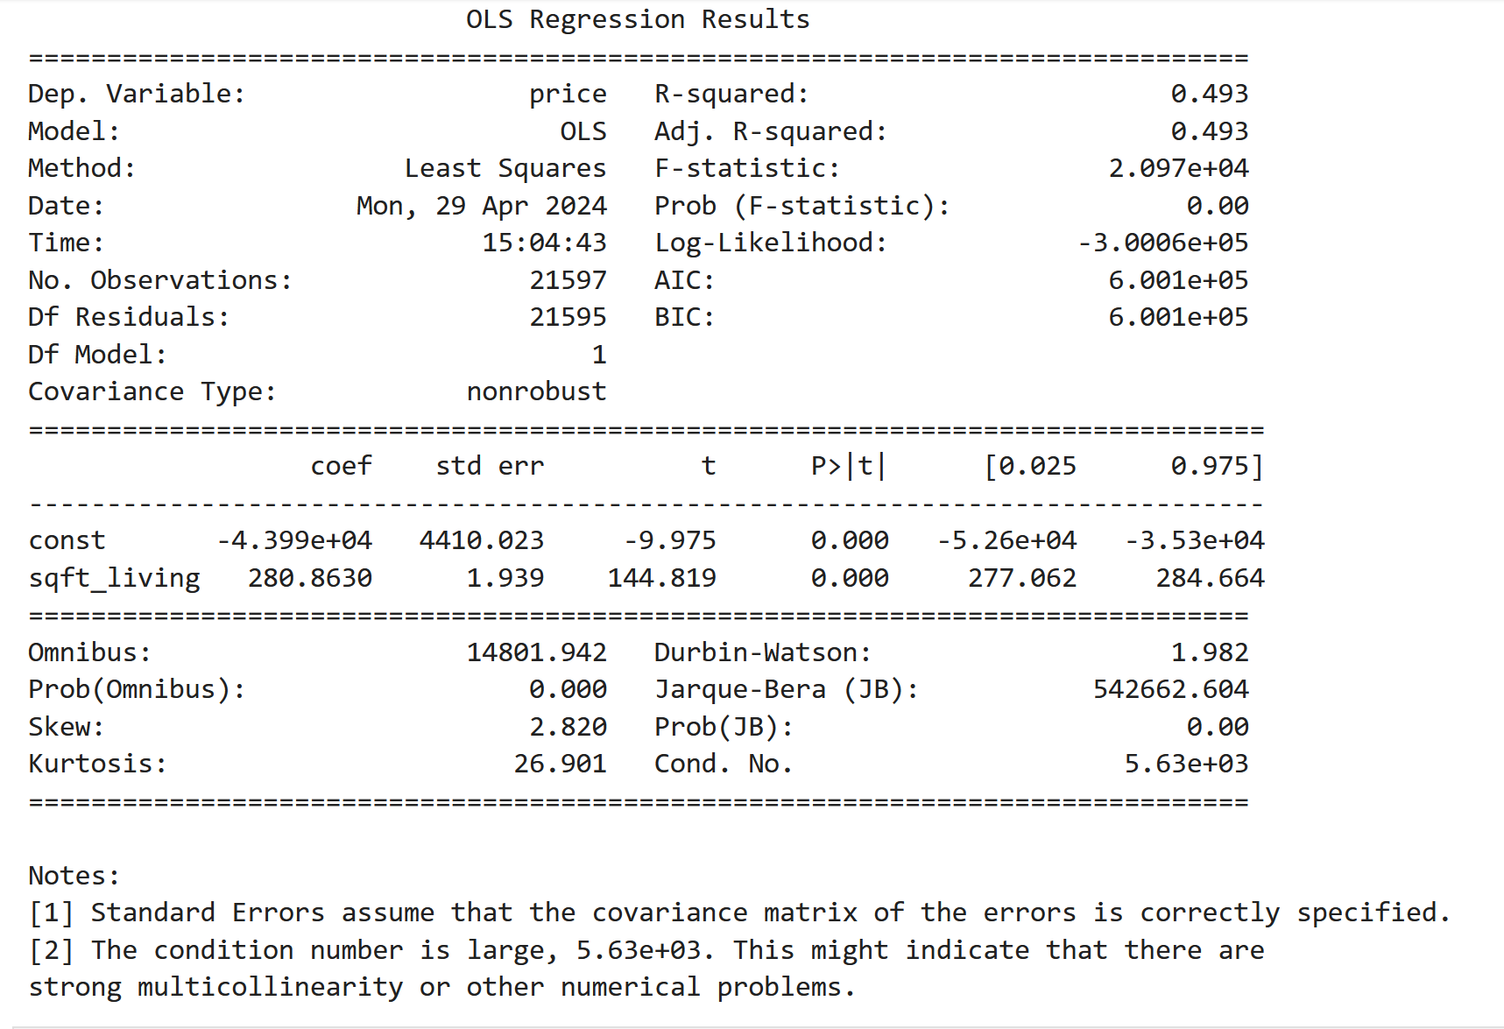

Slide 25
Mean Distribution Error
Value= 173824.8874961748
The model has an R-squared value of 0.49, which means it explains 49% of the variation in price and is statistically significant. The model's predictions deviate by usd 173,824.
The intercept and coefficient for sqft_living are approximately -$43,990 and 281, respectively, both of which are statistically significant.

Slide 26
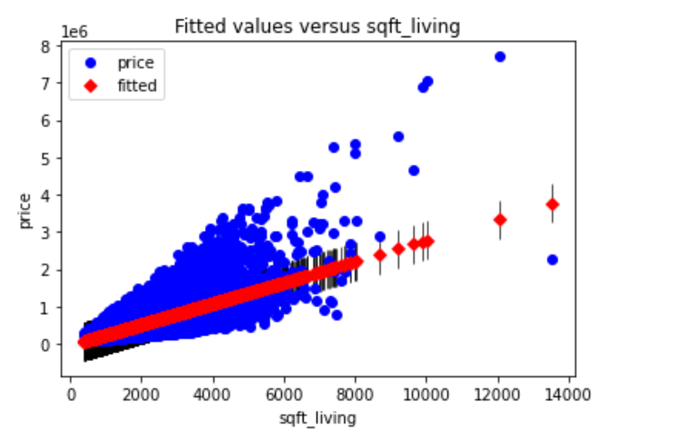
Plot actual results and predicted

Slide 27
KEY TAKEAWAYS
Positive Influencers on Price:
The presence of additional bathrooms, increased square footage, higher floors, waterfront access, captivating views, and elevated grade scores positively impact house prices.
Notably, the inclusion of cities like Medina and Mercer Island in the analysis reveals their positive association with higher property values.
Negative Influencers on Price:
The number of bedrooms, certain city affiliations (e.g., Auburn, Federal Way, Kent), in reference to Bellevue, and specific features (e.g., Fall Season, City) exhibit a negative correlation with house prices.
Premiere Property Group should be cognizant of these factors when devising pricing strategies.
Seasonal and Unique Factors:
While some seasonal variables do not significantly impact prices, it's crucial to note that the age of the house and the presence of a basement can influence pricing dynamics.
City-Specific Considerations:
Each city has a unique influence on house prices, emphasizing the need for tailored strategies for different locations

Slide 28

So as a first recommendation, we would advise focusing on homes on/around the
waterfront and in particular those two neighbourhoods.

Slide 29
OPPORTUNITIES FOR FURTHER ANALYSIS
Micro-Location Trends
Long-Term Market Trends
Economic and Demographic Factors
Economic and Demographic Factors
Advanced Predictive Modeling
Impact of Renovations
Customer Segmentation and Targeting
Impact of External Factors
Notes:
By continuously leveraging data analytics and staying attuned to market trends, Premiere Property Group can maintain a competitive edge in the dynamic King County real estate market.

Slide 30
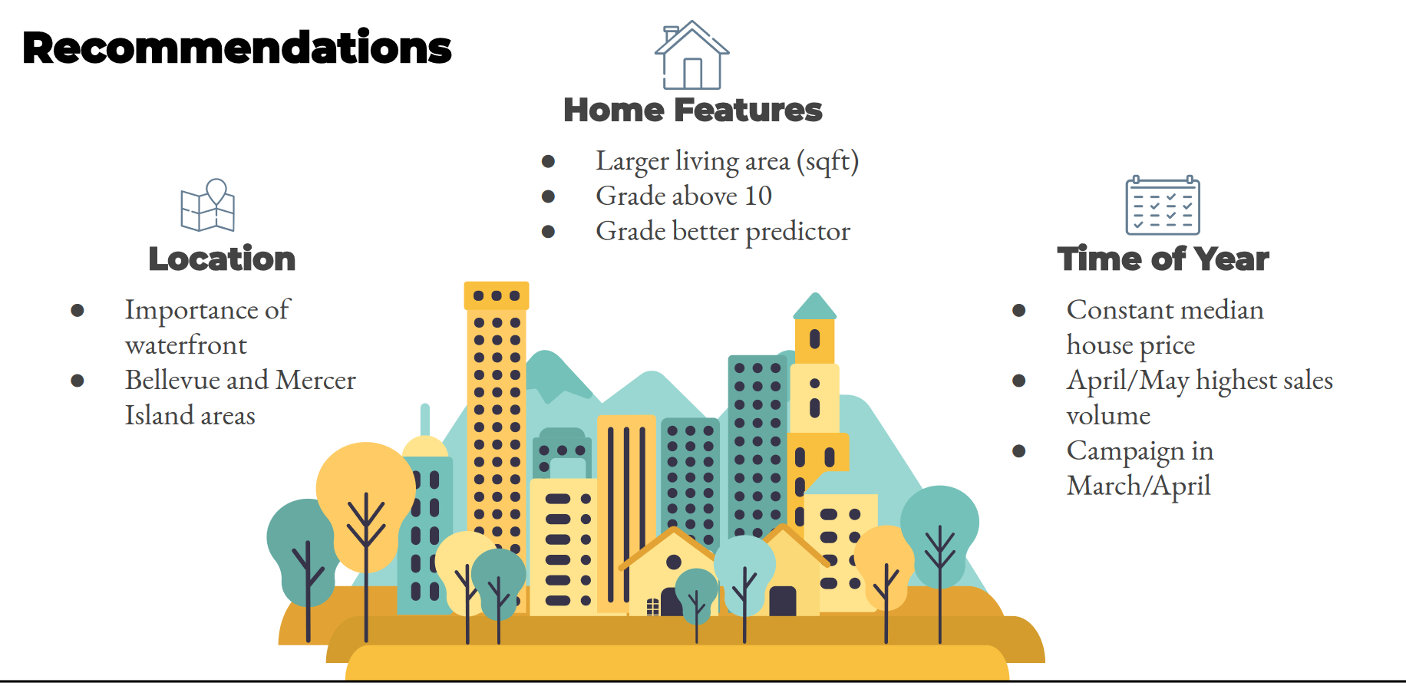

Slide 31
Insights
Key Factors Affecting House Prices: Square footage of living space emerges as the primary driver of house prices. Features like grade, waterfront status, and recent renovations correlate with prices, underscoring their impact on property values.
Significance of Property Characteristics: The number of bedrooms and bathrooms also contributes to determining house prices, albeit with varying degrees of influence.
Neighborhood and Environmental Factors: Proximity to amenities positively correlates with house prices, implying that location remains a critical factor in property valuation.
Modeling and Predictive Insights: Employing regression models such as Simple Linear Regression and Multiple Linear Regression, coupled with iterative modeling and feature engineering techniques, enhances the predictive accuracy of models.

Slide 32
Recommendations
Market Positioning Strategies: Sellers should leverage insights into key price-driving factors to strategically position their properties in the market. Emphasize features eg spacious living areas, recent renovations, and waterfront access to increase property attractiveness and market competitiveness.
Investment Considerations: Investors should carefully evaluate properties based on their potential for value appreciation. Prioritizing investments in neighborhoods with proximity to amenities and waterfront locations could yield higher returns.
Buyer Awareness: Should be cognizant of the factors influencing house prices when making purchasing decisions.

Slide 33
Conclusion
The dataset's geographic and temporal constraints may restrict the generalizability of findings to other regions or time periods.
The analysis equips stakeholders, including homeowners, real estate professionals, and potential buyers, with actionable insights to navigate the housing market effectively.
Leveraging knowledge of key price determinants and understanding the nuances of property valuation, stakeholders can make informed decisions regarding pricing strategies, property investments, and market participation.
Continued research and analysis are warranted to refine models and explore additional factors for enhanced predictive accuracy and comprehensive market understanding.

